Slide 1
One hidden layer
Neural Network
Activation functions
Notes:
Choices for activation functions in hidden layer & outer layer.

Slide 2


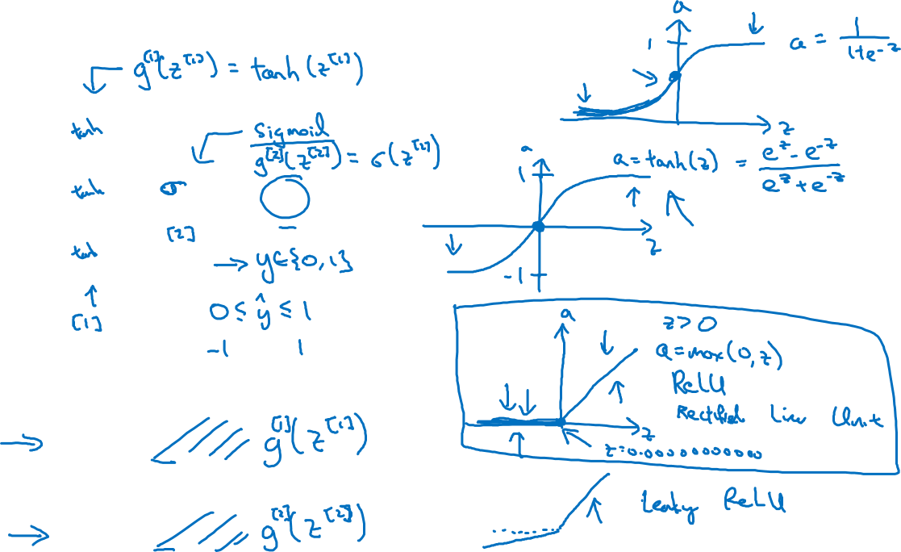




Activation functions
$$x_{1}$$
$$x_{2}$$
$$\hat{y}$$
$$x_{3}$$
Given x:
$$z^{\left[1\right]}=W^{\left[1\right]}x+b^{\left[1\right]}$$
$$a^{\left[1\right]}=σ(z^{\left[1\right]})$$
$$z^{\left[2\right]}=W^{\left[2\right]}a^{\left[1\right]}+b^{\left[2\right]}$$
$$a^{\left[2\right]}=σ(z^{\left[2\right]})$$
Notes:
Tanh function usually , almost works better than sigmoid function. It is a shifted/extended version
What do we mean by working better ? By allowing to go to -1 ?
It turns out that the values between 1 & -1 at the end turns out to have mean closer to 0 . It kind of effect of centering the data. It makes learning for the next layer easier. We will learn more in the 2nd course.
Tanh function is superior except the output layer. When if y is 0 or 1 than it makes sense to output number 0 & 1.
One downside with both these is that, when z is very large or small than slope of these functions becomes close to 0 which results in slowing down of gradient descent.
This is solved with Relu function. In this function as long as z is positive the derivative is 1 & it is 0 when Z is negative ,here when z is is it is not well defined. In practice we can pretend when z = 0 than assume gradient 1 or 0.
Tips:
Relu works well & increasingly default choice in hidden layers.
For output we can use sigmoid.
A disadvantage of negative z value producing 0 gradient does not affect us much in practice however there is another type opf relu called leaky value.
Relu will make NN learn faster, because for majority of Z values the slope is different from 0, therefore in practice it is faster.
Question: Cant we make sigmoid & anh as faster by tuning alpha ?

Slide 3
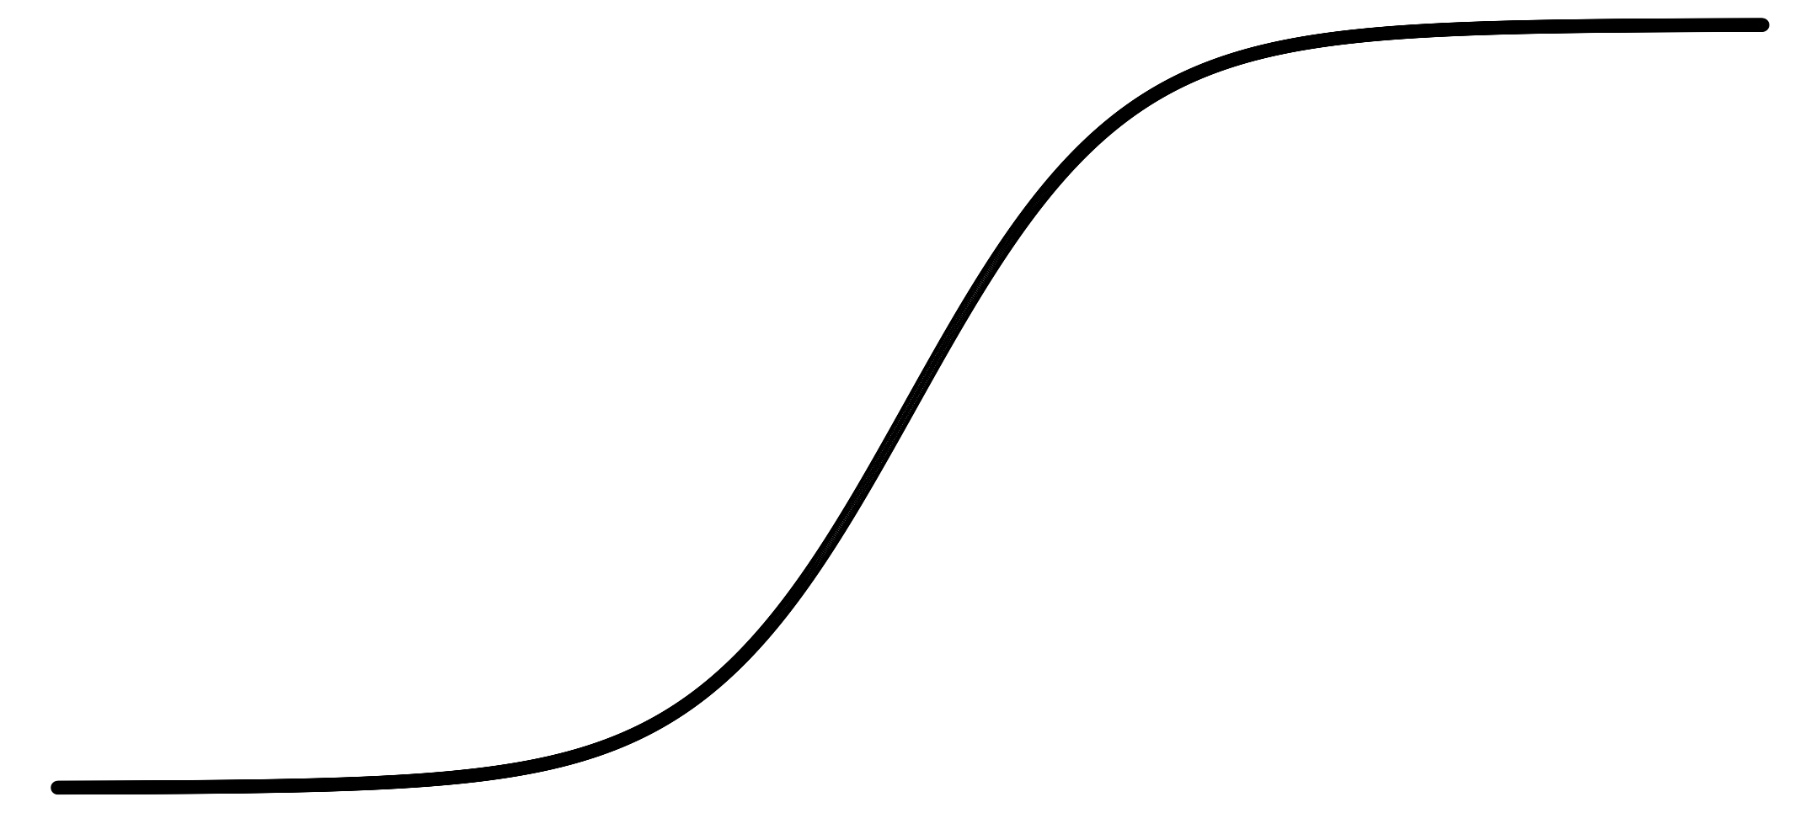
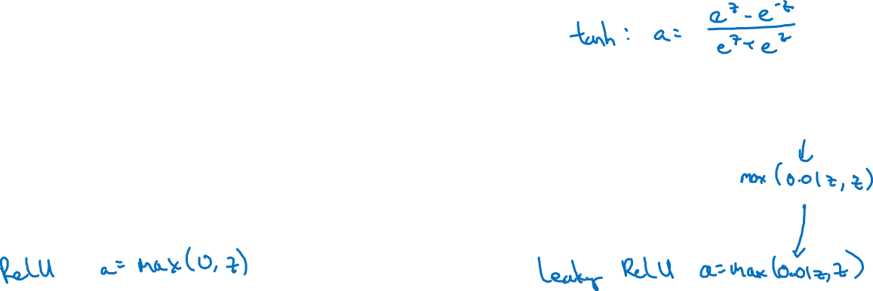
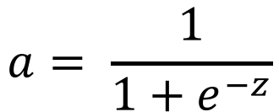
Pros and cons of activation functions
a
a
x
z
$$a= \frac{1}{1+e^{−z}}$$
sigmoid:
a
a
z
z
Notes:
Tan h is superior than sigmoid.
Relu is the default most commonly used.
Feel free to try leaky relu.
Try them all, evaluate .
in next video we will see why do we need non linear activation functions.

